Slide 1
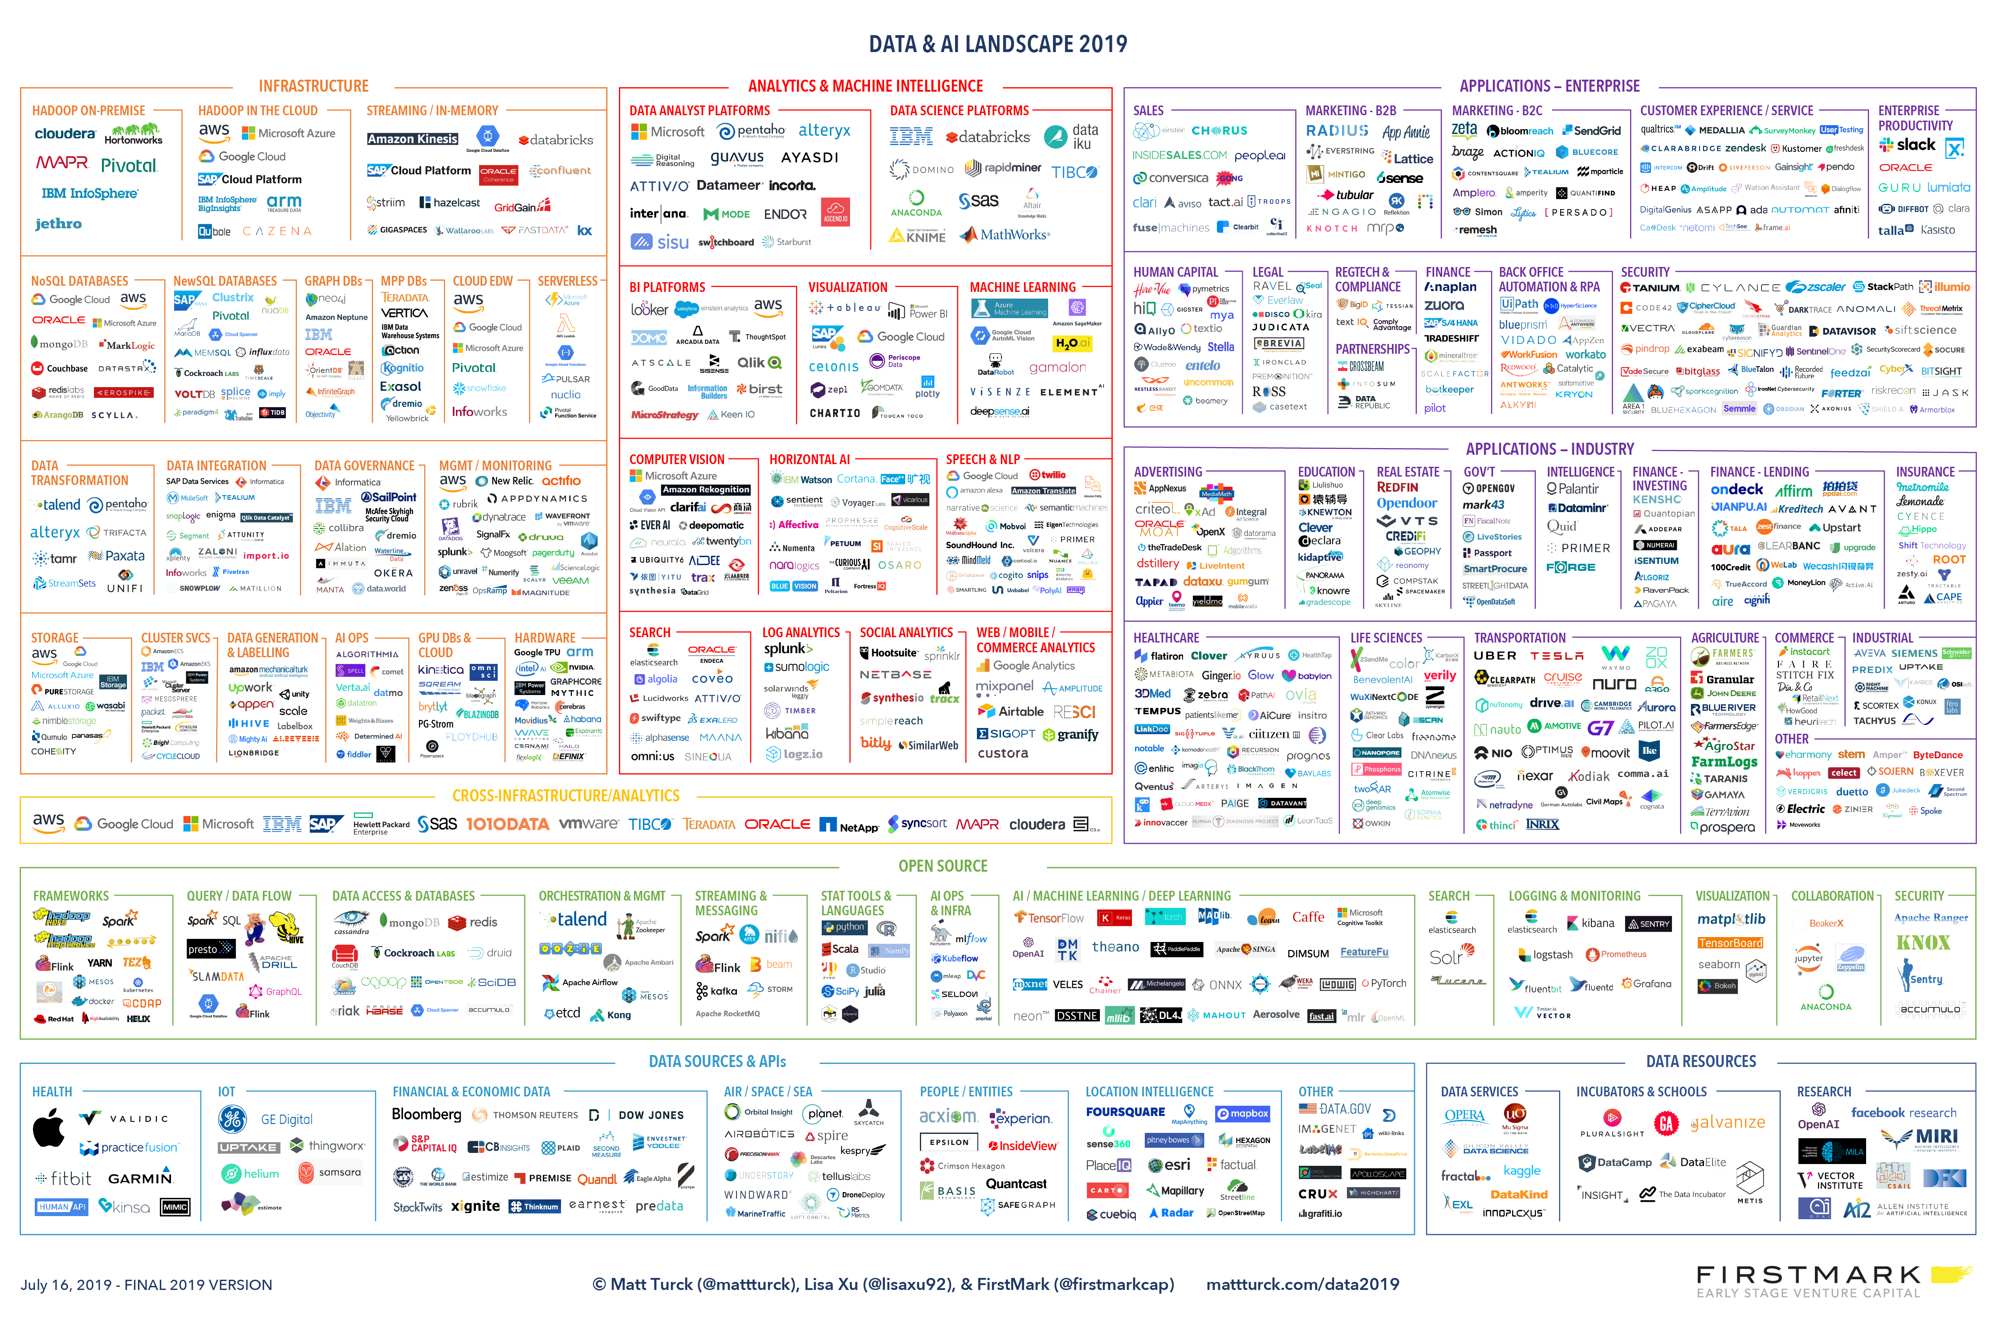

DataOps
An Introduction

Slide 2




AGENDA
INTRODUCTION
TYPES
DEPLOYMENT
USE CASE
QUESTIONS

Slide 3



BCS Technology
BCS Technology is an award winning global IT Professional Services company headquartered in Australia, with offices in India, Singapore, the Philippines, Singapore, Indonesia and Mexico.
We have over 200 skilled professionals in various roles with extensive experience in consulting, software development, project management, business intelligence, ERP and UI design.
www.bcstechnology.com.au

Slide 4













Our Clients
www.bcstechnology.com.au

Slide 6
Three common pipelines
Application DevOps
Requirements
Development
Automated QA
Package
Deploy
MLOps – (machine learning ops)
Discovery
Training
Automated QA
Evaluate
Deploy
DataOps
Extract
Analyse
Transform
Load
Publish
www.bcstechnology.com.au

Slide 7
Three common pipelines
We are here!
Application DevOps
Requirements
Development
Automated QA
Package
Deploy
MLOps – (machine learning ops)
Discovery
Training
Automated QA
Evaluate
Deploy
DataOps
Extract
Analyse
Transform
Load
Publish
www.bcstechnology.com.au

Slide 8
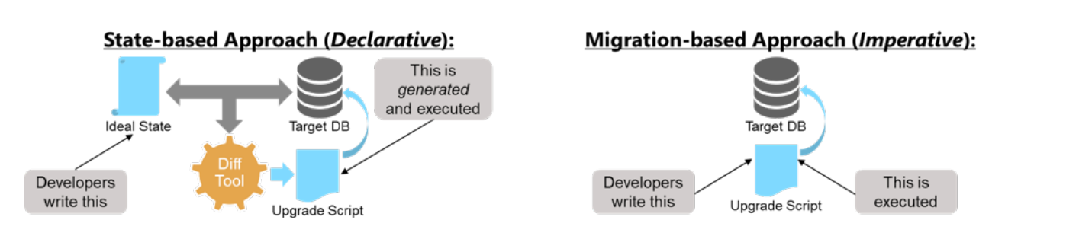
We discussed 2 methods
www.bcstechnology.com.au

Slide 9
We discussed 2 methods
We are here!
www.bcstechnology.com.au

Slide 10
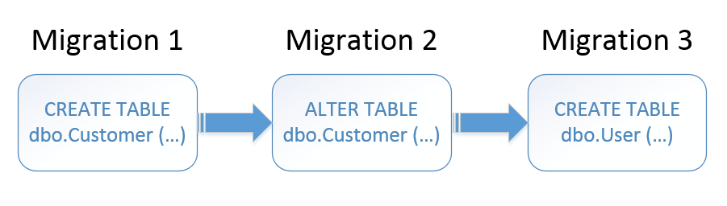
Migration based deployments
www.bcstechnology.com.au

Slide 11
Two common ways
Plain SQL
Programmatic (often DSL based)
/* make sure that we are on the right database */
IF NOT EXISTS (SELECT * FROM sys.types WHERE name LIKE ‘dksh')
OR Object_Id(‘Markets') IS NULL
BEGIN
RAISERROR('Error. this migration script needs a version of the DKSH Database', 16, 1);
END;
/* we check to see whether the Users table is already created,
meaning this script is being accidentally re-run.
No bother, we simply do nothing rather than scream and trigger an error */
IF Object_Id(‘Users') IS NULL
BEGIN
PRINT 'creating the Users table'
CREATE TABLE Users (
User_ID INT IDENTITY(1, 1) PRIMARY KEY,
Name VARCHAR(20) NOT NULL UNIQUE);
END
ELSE --do nothing besides sending a message
PRINT 'The Users table already exists. Nothing to do.'
[Migration(1)]
public class CreateUserTable : Migration
{
public override void Up()
{
Create.Table("Users");
}
public override void Down()
{
Delete.Table("Users");
}
}
www.bcstechnology.com.au

Slide 12
We are here!
Two common ways
Plain SQL
Programmatic (often DSL based)
/* make sure that we are on the right database */
IF NOT EXISTS (SELECT * FROM sys.types WHERE name LIKE ‘dksh')
OR Object_Id(‘Markets') IS NULL
BEGIN
RAISERROR('Error. this migration script needs a version of the DKSH Database', 16, 1);
END;
/* we check to see whether the Users table is already created,
meaning this script is being accidentally re-run.
No bother, we simply do nothing rather than scream and trigger an error */
IF Object_Id(‘Users') IS NULL
BEGIN
PRINT 'creating the Users table'
CREATE TABLE Users (
User_ID INT IDENTITY(1, 1) PRIMARY KEY,
Name VARCHAR(20) NOT NULL UNIQUE);
END
ELSE --do nothing besides sending a message
PRINT 'The Users table already exists. Nothing to do.'
[Migration(1)]
public class CreateUserTable : Migration
{
public override void Up()
{
Create.Table("Users");
}
public override void Down()
{
Delete.Table("Users");
}
}
www.bcstechnology.com.au

Slide 13



Running the scripts
Manual Crafting
Using a tool
if (object_ID('dbo.DeleteMePlease') is not null)
DROP FUNCTION dbo.DeleteMePlease
GO
CREATE FUNCTION dbo.DeleteMePlease(@MyParameter int)
RETURNS int
WITH EXECUTE AS CALLER
AS BEGIN
RETURN(@MyParameter * 1000)
END GO
(free)
(paid)
Redgate SQL change automation
www.bcstechnology.com.au

Slide 14
We are here!
Running the scripts
Manual Crafting
Using a tool
if (object_ID('dbo.DeleteMePlease') is not null)
DROP FUNCTION dbo.DeleteMePlease
GO
CREATE FUNCTION dbo.DeleteMePlease(@MyParameter int)
RETURNS int
WITH EXECUTE AS CALLER
AS BEGIN
RETURN(@MyParameter * 1000)
END GO
(free)
(paid)
Redgate SQL change automation
www.bcstechnology.com.au

Slide 15
Concepts
Idempotency
An idempotent SQL script is one that has no additional effect if it is called more than once
-
www.bcstechnology.com.au

Slide 16
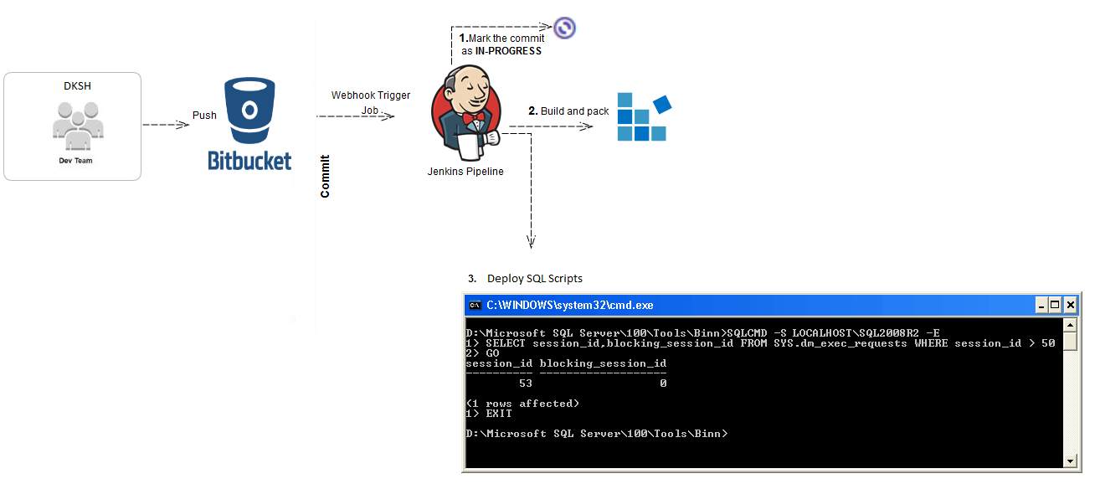
Run here!
www.bcstechnology.com.au

Slide 17
Triggering the deploy
sqlcmd -i C:\Automation\MyIdempotentScript.sql -o C:\Results\MyOutput.txt
-S <Servername>
-U <Username>
-P <Password>
www.bcstechnology.com.au

Slide 18

Questions?
www.bcstechnology.com.au

Slide 19

Thank You
JONATHAN PEREZ
jonathan.perez@bcstechnology.com.au
+61 432 652 425 (Australia)
www.bcstechnology.com.au

